Slide 1
Warm Fuzzies
&
Cold Pricklies
Notes:
Hello everyone and thank you for taking the time out of your busy day to listen to me. I am child’s name mom/dad and I am hear today to talk about HOW…

Slide 2
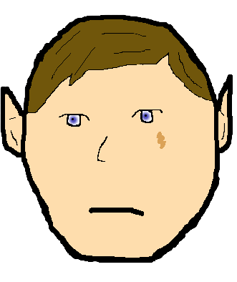
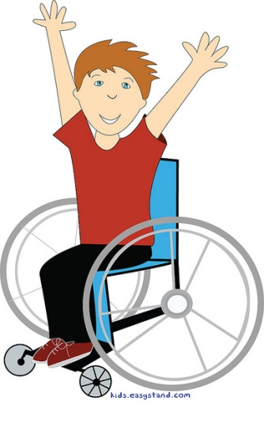
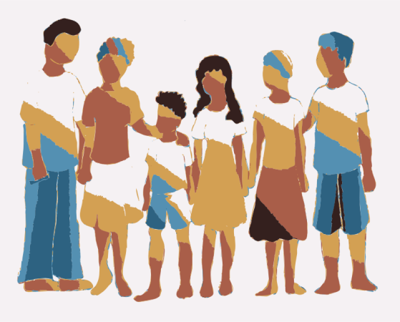
We are ALL special
Doctor Appointments
School Activities
Friends/Family
Birthmarks
Notes:
We are ALL special. No matter what everyone is special.
Have you ever been to a doctor appointment?
Do you like going to the doctor?
What makes us special or unique?? (talk about these different things)
We all go to school and have activities that we like doing. Who likes playing outside? Who likes running around and playing tag?
Everyone has friends and family that they love being around, right? Some of us might have 2 moms and 2 dads, others may live with their grandparents. Some of us may live close to our family and others may be in a different state
Birthmarks are another thing that makes us all special. You may have a birth mark that you know about or even one that you don’t know about. You may wear glasses or have braces. Or have to use a wheelchair to get around.
These are all things that make us special in our own way.

Slide 3
Why (insert child’s name) is special
Bodies all work differently
Doctor Appointments
Extra Medications
Pokes
Different smells
Yucky feeling
Notes:
Since we now know everyone is special, I am going to tell you why child’s name is special. Everyone’s bodies work a little differently, but Child’s name body doesn’t work like our body does. Child’s name body doesn’t get rid of the bad things in it, like ours do. Our bodies are able to take all the bad things that may go into them, and get them out. Since his/her body works differently, he has to go to the doctor more often and take more medicines to keep his body working right and to help all those bad things stay out of his body.
How many people in here have ever taken medicine? (interactive time-get kids involved)
How many people have ever seen someone take medicine? (interactive time-get kids involved)
What did your medicine taste like? (interactive time-get kids involved)
Why did you take your medicine? (interactive time-get kids involved)
So everyone takes medicine to feel better, right? So, everyone took the medicine to feel better, well child name has to take his/her medicine to feel better. If he/she did not take the medicine she/he would not feel good EVER. The medicine that he/she takes doesn’t smell very good but it is the only thing that will make them be able to play and act just like you and me.
What if your medicine was icky? (interactive time-get kids involved)
What if it made your tummy hurt or tasted bad? Would you still take it? (interactive time-get kids involved)
Child’s name has to take his/her medicine because it is the only thing that makes him/her healthy.
If applicable add in how your child takes his/her medication if desired

Slide 4
Medications
Cystagon (example)
Cytra K (example)
Hydroxyzine (example)
Levothyroxine (example)
Levocarnitine (example)
Phosphate (example)
Notes:
This is a list of the medicine Child’s name has to take every 6 hours (or twelve).
(Take this time to talk about the medicine your child HAS to take to be healthy. You may bring in the pills or syringes to show them the medicine.)
At this point display medications given in one day and pass around a NEW bottle of Cystagon (smell is more potent and the children will get the idea).
We do this because if the kids can SMELL this medicine, it allows them to understand a bit better why our kids may have a smell. This is a great interactive time for the kids!!
Tell them that this list of medications is specific to your child. Explain that your child needs these medications to live and stay healthy. Also discuss the medication times and how it interrupts their sleep and their fun activities.

Slide 5
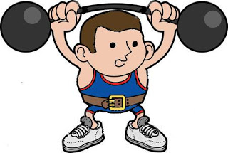
Choices:
Be Tough
Stay Strong
Stay Alive
Notes:
We ALL have choices. Now that you have smelt and seen the medicine what would your choice be? Would you take the medicine or would you not?
If you chose to not take the medicine then you would not be able to play, you would have to spend a lot of time in the hospital, you would feel very sick and in the end you could die (if you want to be honest).
Sometimes we choose to cry and scream when we don’t get our way and sometimes we choose to be tough and strong. Child’s name has to choose to be strong EVERY SINGLE day. He/she has to take his medicine every 6 hours to be like the rest of us and be able to play and have fun.
These medications sometimes make our bodies or breathe smell. We wash our bodies, we brush our teeth and no matter how much we try the medicine can still come out of our skin and smells.
If you smell something icky on he/she you need to remember that it is the medicine, please do not pick on them and be nice so we don’t hurt anyone’s feelings. Especially because he/she NEEDS this medication and there is no other medication that will make him/her feel better. This is their only option.
As we talk about hurting peoples feelings, we have to understand that the things we say to people or how we say things could really hurt someone’s feelings, or it could really make them feel good. How we talk to someone or what we say is so very important, not only for Child’s name, but for ANYONE!!

Slide 6
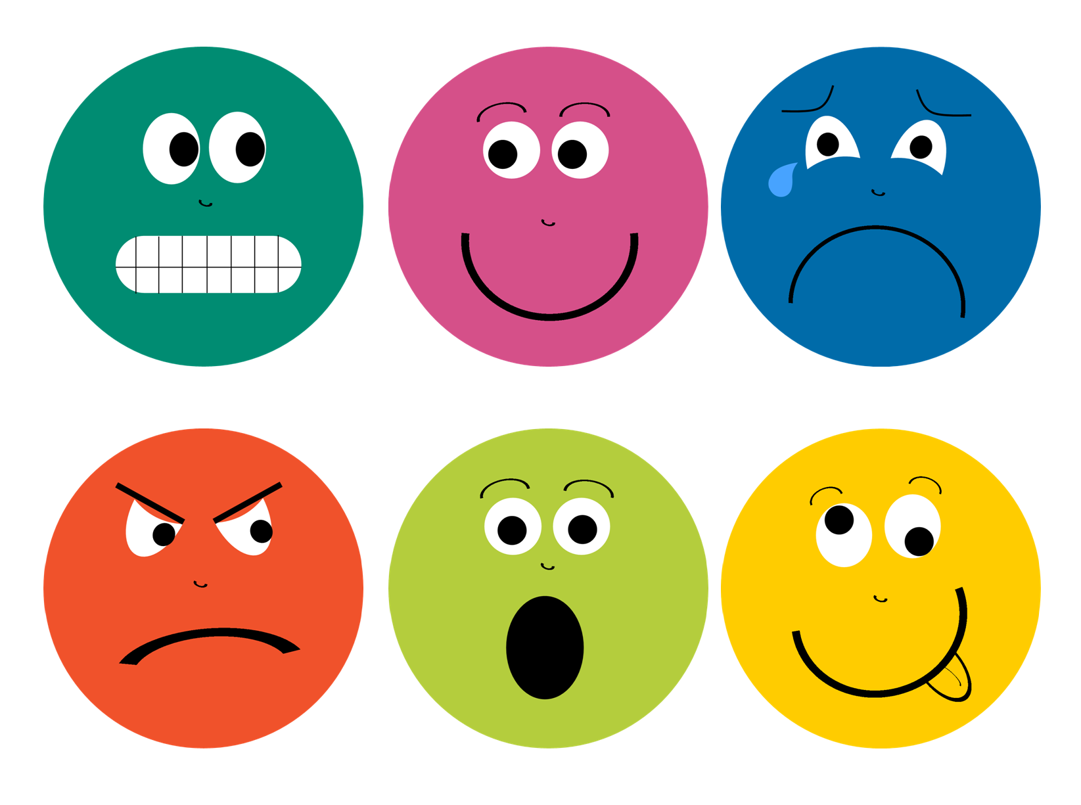
What we say could………
HURT
Or
HELP
Notes:
When you say something , be sure you know how that will make the other person feel.
HOW we say something is so important to everyone in this class and this school. Not only my son/daughter, but anyone who is special or unique.
I brought something very special with me today. I have two things here. One is a WARM FUZZY and one is a COLD PRICKLY!! (have your two items here and place them in fornt of the children. Have them see each item as you tell them what each one is)

Slide 7
Warm Fuzzies
Notes:
Here is my WARM FUZZY!
Who can tell me what they think a warm fuzzy is?
Warm fuzzies are things that make people feel good. Saying or doing something that makes someone feel warm and happy inside.
What would be something you could say to someone that would make them feel warm and fuzzy?
Interaction: PASS AROUND A TEDDY BEAR OR A BALL WRAPPED IN FLANNEL
Explain how this warm fuzzy is soft, warm and feels good when we touch it. Just like how we treat others, what we say to them also makes them feel warm and fuzzy.

Slide 8
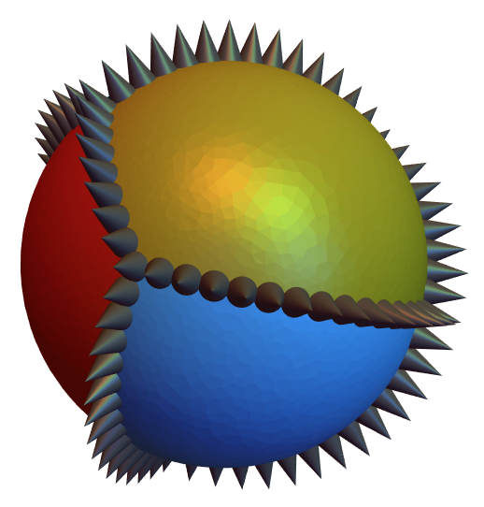
Cold Pricklies
Notes:
Here is my COLD PRICKLY! OUCH!! See how it is SO different from the WARM FUZZY?
Who can tell me what they think a cold prickly is?
Cold pricklies are things that hurt. Saying or doing something that makes someone feel bad or sad. Having someone be mean to you, or say a mean thing, it hurts very bad. It hurts just like the pricklies do when I squeeze this ball. It hurts just like being treated badly.
When people say hurtful things to others it can feel like pricklies.
Interaction: PASS AROUND A STYROFOAM BALL WITH TOOTHPICKS STICKING OUT
Talk about some examples of how people can say mean things. How can we turn these things into warm fuzzies? If son/daughter smells like the medicine, do we tell them how stinky they are? That would be a cold prickly. We don’t ever want to treat anyone badly, nor do we want to hurt anyones feelings.

Slide 9
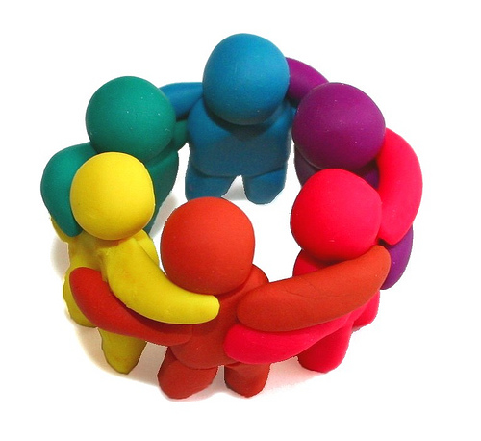
REMEMBER….
We want EVERYONE to feel good, so remember what you say or DO could make someone feel warm and fuzzy or cold and prickly!!

Slide 10
Questions???

